Slide 1
Offline Checklists - How to Import
EPRM v3.64, July 2024
EPRM User Support: eprmhelp@hii-tsd.com
1.800.754.4204

Slide 2
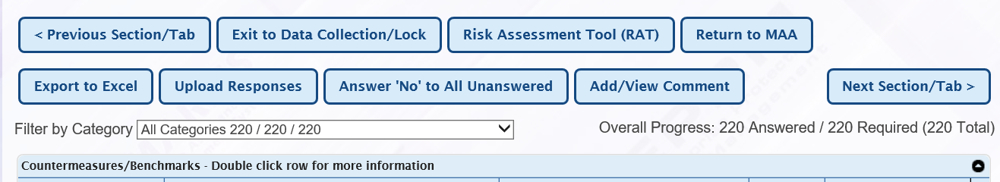
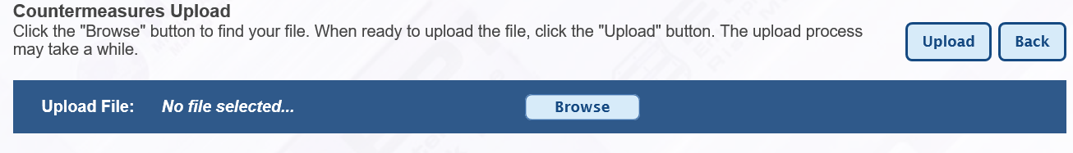
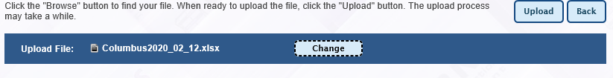
Import an Offline Checklist:
You will need to utilize DOTS to send your completed offline checklist to your SIPRNET email by following the process below.
1. Send the completed checklist (.xlsx) document from your NIPRNET computer to your SIPRNET email account using the DOTS site. DOTS is a web transfer portal that allows you to send files from a NIPRNET computer to your SIPRNET email account - https://dots.dodiis.mil/
2. DOWNLOAD the file from your SIPRNET email and save to your computer.
3. Login to EPRM and start a new assessment (or open an existing assessment).
4. Walk through the step by step process and when you get to the “Countermeasures” section, select the “Upload Responses” button.
5. BROWSE your computer for the completed checklist (.xlsx) document, click “Upload”.
6. EPRM will import the answers and comments, and it will be just as though you entered the data at your SIPR workstation.

